Slide 1

7th Grade Accelerated Math
Unit 3, Lesson 2 Quotient Laws of Exponents Volume 1, pg. 106

Slide 2


Benchmark
MA.7.NSO.1.1
Know and apply the Laws of Exponents to evaluate numerical expressions and generate equivalent numerical expressions, limited to whole-number exponents and rational number bases.
volume 1, pg. 106

Slide 3
Integrated Mathematical Thinking and Reasoning Standards
MA.K12.MTR.1.1 Actively participate in effortful learning both individually and collectively.
MA.K12.MTR.4.1 Engage in discussions that reflect on the mathematical thinking of self and others.
MA.K12.MTR.5.1 Use patterns and structure to help understand and connect mathematical concepts.
MA.K12.MTR.6.1 Assess the reasonableness of solutions.
volume 1, pg. 106

Slide 4

Learning Target
I can explain and use the quotient of powers, power of a quotient, and zero exponent laws.
volume 1, pg. 106

Slide 5

Warm-Up
volume 1, pg. 106

Slide 6
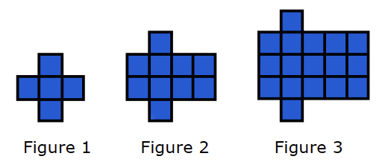
3.2.1 Warm-Up: Use a Pattern
Look at the pattern shown in the figures below. Work with your partner to answer the questions.
Describe the pattern in words.
If the pattern continued, how many squares would be in Figure 10?
volume 1, pg. 106

Slide 7

Activity
volume 1, pg. 107

Slide 8

3.2.2 Activity: Station 1: Quotient of Powers Exponent Law
Work with your partner or a small group to complete three stations involving the laws of exponents.
Task 1:
Review the steps Rosa, Victor, and Emma each used to generate an equivalent expression. Then, answer the questions that follow.
volume 1, pg. 107

Slide 9
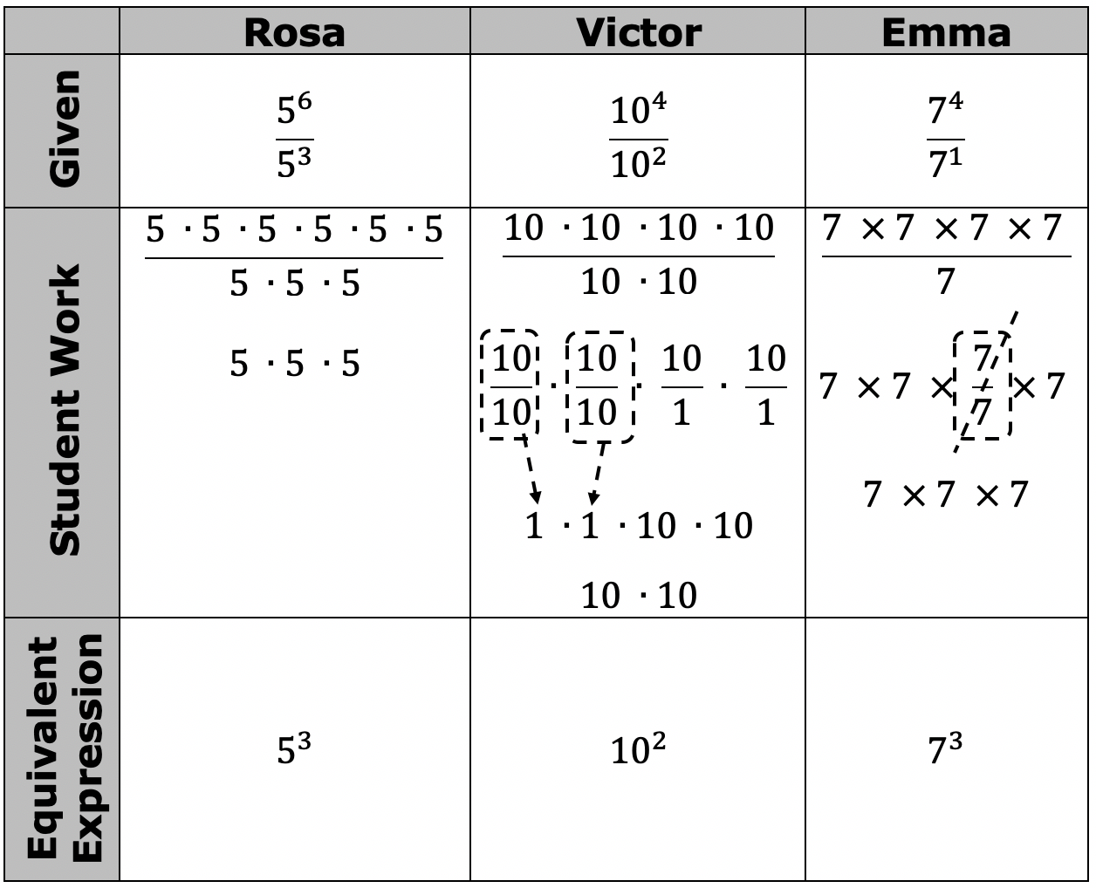
volume 1, pg. 107

Slide 10
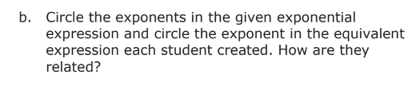
What do you notice about the bases of the numerator and denominator of each given exponential expression?
volume 1, pg. 107

Slide 11

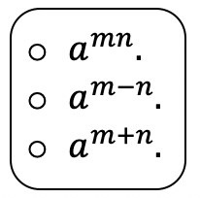

Task 2:
Fill in the blank to complete the rule for dividing exponential expressions with the same bases.
When$a$ is a nonzero real number, and $m$ and $n$ are integers, the exponential expression $\frac{a^{m}}{a^{n}}$ is equal to
When dividing two powers that have the same nonzero base, keep the base and the exponents. This is called the quotient of powers exponent law.
volume 1, pg. 107

Slide 12

Task 3: Show your steps of applying the quotient of powers exponent law to evaluate.
$\frac{{\left(−2\right)}^{6}}{{\left(−2\right)}^{3}}$
$\frac{{\left(3\right)}^{6}}{{\left(3\right)}^{2}}$
$\frac{{\left(−7\right)}^{4}}{{\left(−7\right)}^{1}}$
volume 1, pg. 107

Slide 13
Activity
volume 1, pg. 108

Slide 14
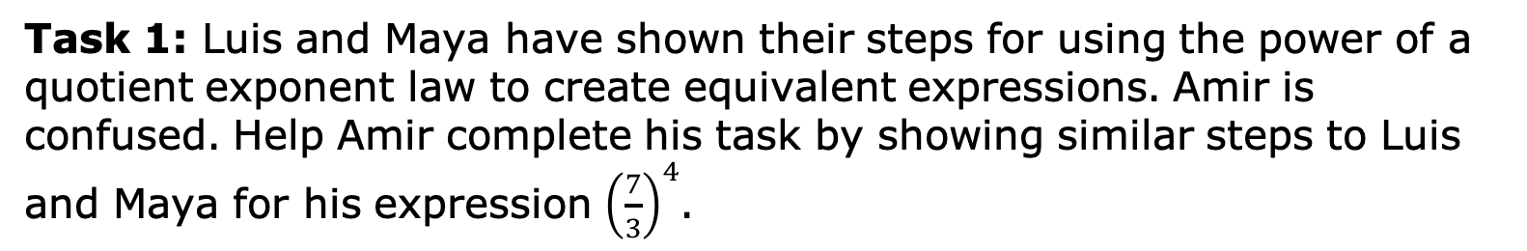
3.2.3 Activity: Station 2: Power of a Quotient Exponent Law
Task 1: Luis and Maya have shown their steps for using the power of a quotient exponent law to create equivalent expressions. Amir is confused. Help Amir complete his task by showing similar steps to Luis and Maya for his expression ${\left(\frac{7}{3}\right)}^{4}$.
volume 1, pg. 108

Slide 15
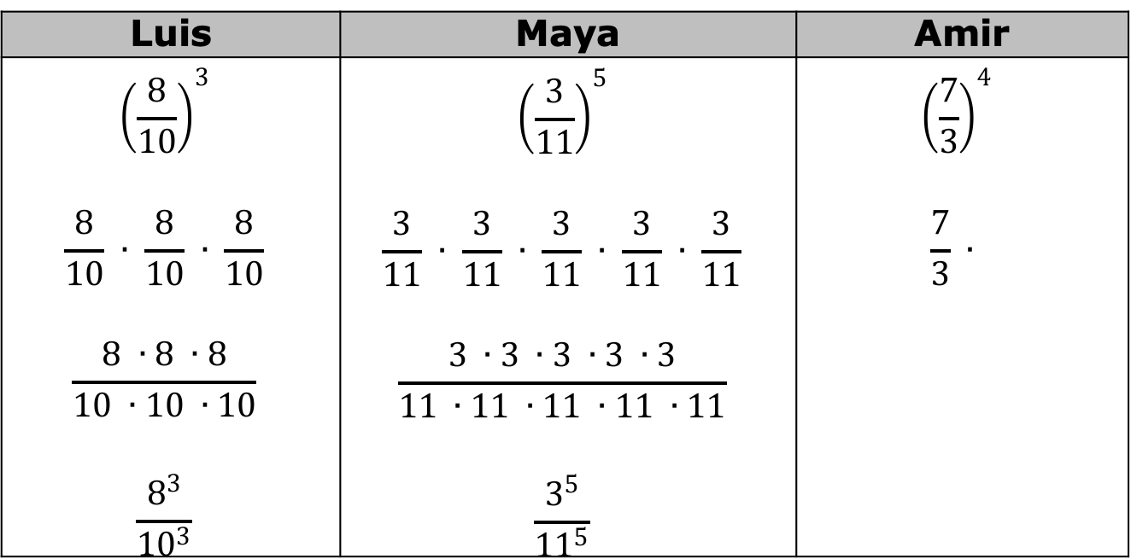
Luis | Maya | Amir
$${\left(\frac{8}{10}\right)}^{3}$$ $$\frac{8}{10} ∙ \frac{8}{10} ∙ \frac{8}{10}$$ $$\frac{8 ∙8 ∙8}{10 ∙10 ∙10}$$ $$\frac{8^{3}}{{10}^{3}}$$ | $${\left(\frac{3}{11}\right)}^{5}$$ $$\frac{3}{11} ∙ \frac{3}{11} ∙ \frac{3}{11} ∙ \frac{3}{11} ∙ \frac{3}{11}$$ $$\frac{3 ∙3 ∙3 ∙3 ∙3}{11 ∙11 ∙11 ∙11 ∙11}$$ $$\frac{3^{5}}{{11}^{5}}$$ | $${\left(\frac{7}{3}\right)}^{4}$$ $$\frac{7}{3} ∙$$
volume 1, pg. 108

Slide 16
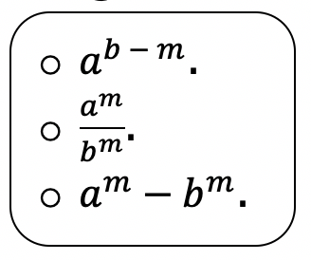

Task 2:
Fill in the blank to complete the rule for raising a fraction to a power.
When $a$ and $b$ are nonzero real numbers, and $m$ is an integer, the exponential expression ${\left(\frac{a}{b}\right)}^{m}$ is equal to
When raising a fraction to a power, the result is equal to the quotient of the numerator and denominator raised separately to the power. This is called the power of a quotient exponent law.
volume 1, pg. 108

Slide 17

Task 3: Apply the power of quotient exponent law. Do not simplify the fractions.
${\left(\frac{−4}{8}\right)}^{2}$
${\left(\frac{−4}{−2}\right)}^{6}$
${\left(\frac{2}{−8}\right)}^{5}$
volume 1, pg. 108

Slide 18
Activity
volume 1, pg. 109

Slide 19
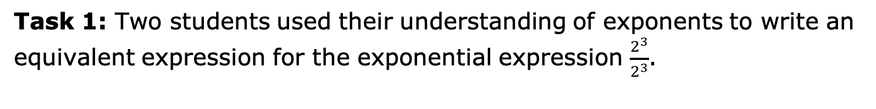
3.2.4 Activity: Station 3: Zero Exponent Law
Task 1: Two students used their understanding of exponents to write an equivalent expression for the exponential expression $\frac{2^{3}}{2^{3}}$.
volume 1, pg. 109

Slide 20
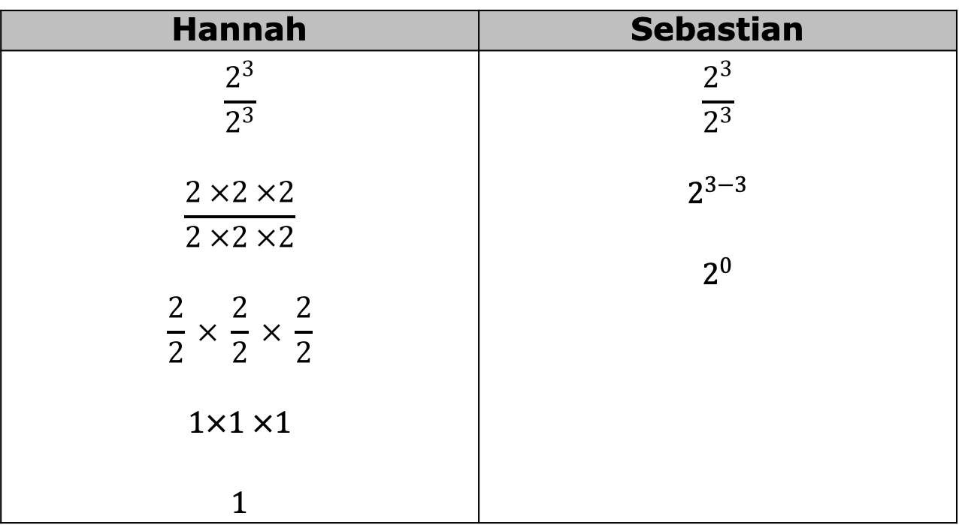
Discuss each step that the students completed.
Hannah | Sebastian
$$\frac{2^{3}}{2^{3}}$$ $$\frac{2 ×2 ×2}{2 ×2 ×2}$$ $$\frac{2}{2} × \frac{2}{2} × \frac{2}{2}$$ $$1×1 ×1$$ $$1$$ | $$\frac{2^{3}}{2^{3}}$$ $$2^{3−3}$$ $$2^{0}$$
volume 1, pg. 109

Slide 21
Using Hannah’s and Sebastian’s work, make a prediction about the value of any number raised to the power of $0$.
volume 1, pg. 109

Slide 22
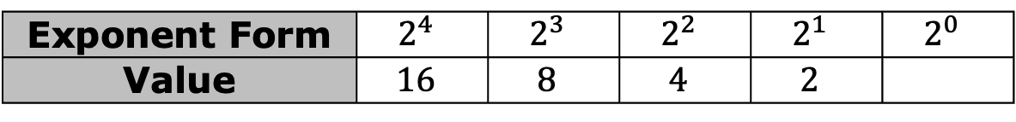

Task 2: Use the tables to answer the questions.
Exponent Form | $$2^{4}$$ | $$2^{3}$$ | $$2^{2}$$ | $$2^{1}$$ | $$2^{0}$$
Value | $$16$$ | $$8$$ | $$4$$ | $$2$$
Exponent Form | $$3^{4}$$ | $$3^{3}$$ | $$3^{2}$$ | $$3^{1}$$ | $$3^{0}$$
Value | $$81$$ | $$27$$ | $$9$$ | $$3$$
What pattern do you see in the top row of each table?
What pattern do you see in the bottom row of each table?
How is the pattern in the bottom row of each table related to the value of the base in the top row of the table?
volume 1, pg. 109

Slide 23
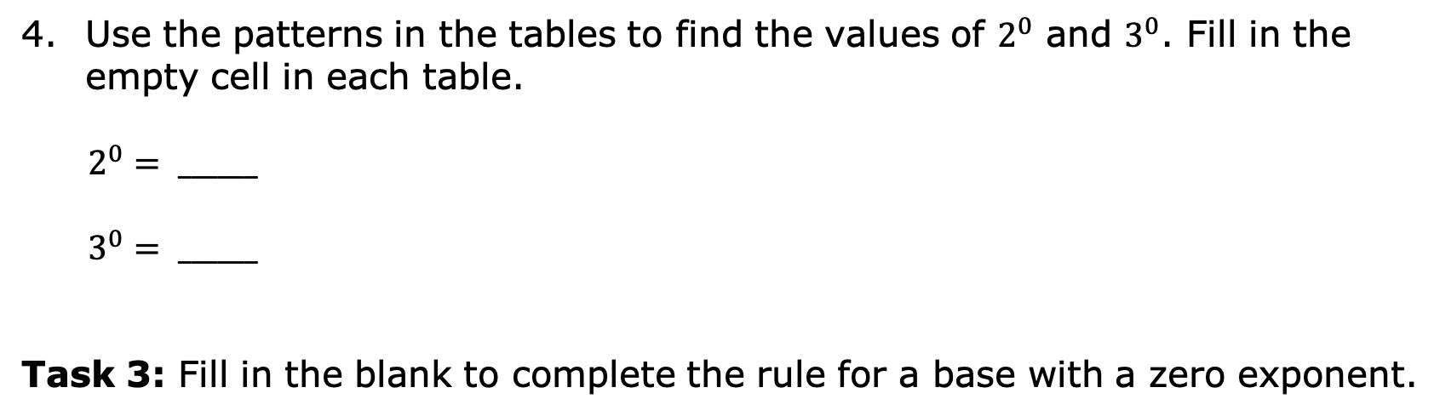
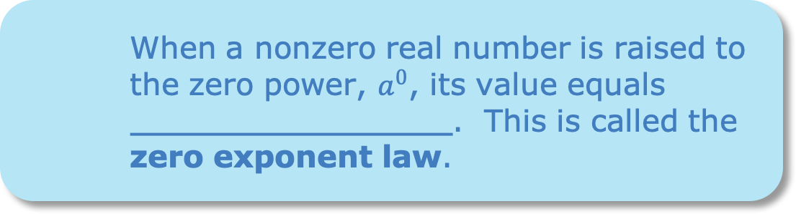
Use the patterns in the tables to find the values of $2^{0}$ and $3^{0}$. Fill in the empty cell in each table.
$2^{0}= ______$
$3^{0}= ______$
Task 3: Fill in the blank to complete the rule for a base with a zero exponent.
When a nonzero real number is raised to the zero power, $a^{0}$, its value equals . This is called the zero exponent law.
volume 1, pg. 109

Slide 24

Bring It Together
volume 1, pg. 110

Slide 25

3.2.5 Bring It Together: Exponential Expressions with Rational Bases
Match each set of expressions with the Exponent Law that it demonstrates. Use arrows to indicate matches.
volume 1, pg. 110

Slide 26
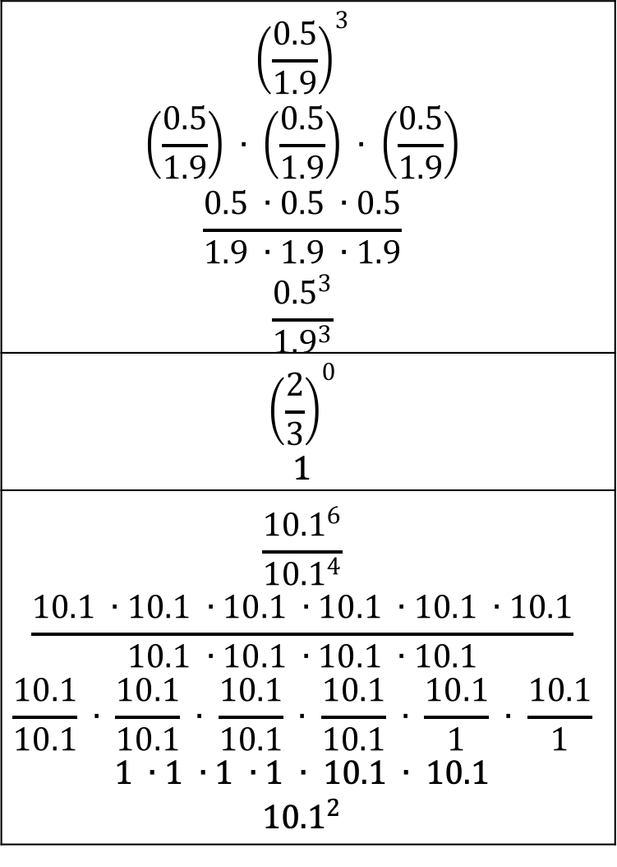
$${\left(\frac{0.5}{1.9}\right)}^{3}$$ $$\left(\frac{0.5}{1.9}\right) ∙ \left(\frac{0.5}{1.9}\right) ∙ \left(\frac{0.5}{1.9}\right)$$ $$\frac{0.5 ∙0.5 ∙0.5}{1.9 ∙1.9 ∙1.9}$$ $$\frac{{0.5}^{3}}{{1.9}^{3}}$$
$${\left(\frac{2}{3}\right)}^{0}$$ $$1$$
$$\frac{{10.1}^{6}}{{10.1}^{4}}$$ $$\frac{10.1 ∙10.1 ∙10.1 ∙10.1 ∙10.1 ∙10.1}{10.1 ∙10.1 ∙10.1 ∙10.1}$$ $$\frac{10.1}{10.1} ∙ \frac{10.1}{10.1} ∙ \frac{10.1}{10.1} ∙ \frac{10.1}{10.1} ∙ \frac{10.1}{1} ∙ \frac{10.1}{1}$$ $$1 ∙1 ∙1 ∙1 ∙ 10.1 ∙ 10.1$$ $${10.1}^{2}$$
Zero Exponent Law
Quotient of Powers Law
Power of a Quotient Law
volume 1, pg. 110

Slide 27
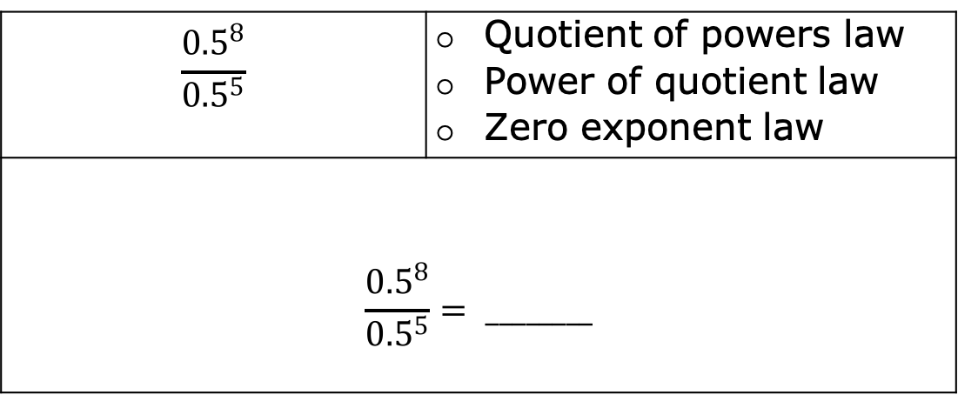
Complete the following steps for each expression.
Rewrite each expression shown by using the laws of exponents.
Check off the exponent law used from the list.
Evaluate the exponential expression.
$$\frac{{0.5}^{8}}{{0.5}^{5}}$$ | Quotient of powers law Power of quotient law Zero exponent law
$$\frac{{0.5}^{8}}{{0.5}^{5}}= ________$$
volume 1, pg. 110

Slide 28
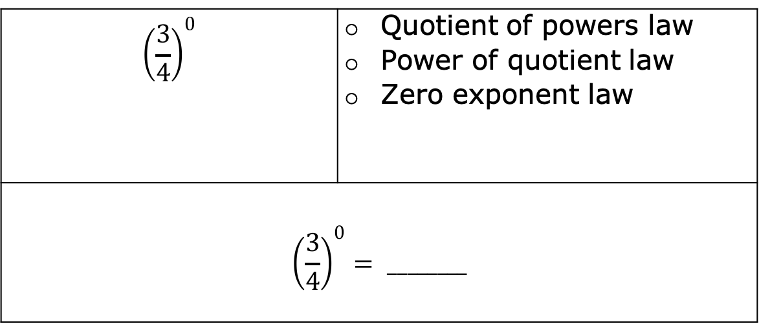
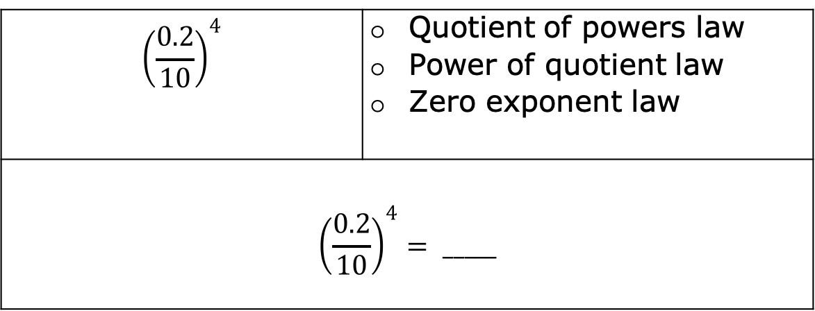
$${\left(\frac{0.2}{10}\right)}^{4}$$ | Quotient of powers law Power of quotient law Zero exponent law
$${\left(\frac{0.2}{10}\right)}^{4}= _____$$
$${\left(\frac{3}{4}\right)}^{0}$$ | Quotient of powers law Power of quotient law Zero exponent law
$${\left(\frac{3}{4}\right)}^{0}= ________$$
volume 1, pg. 110

Slide 29

Your Turn
volume 1, pg. 111

Slide 30
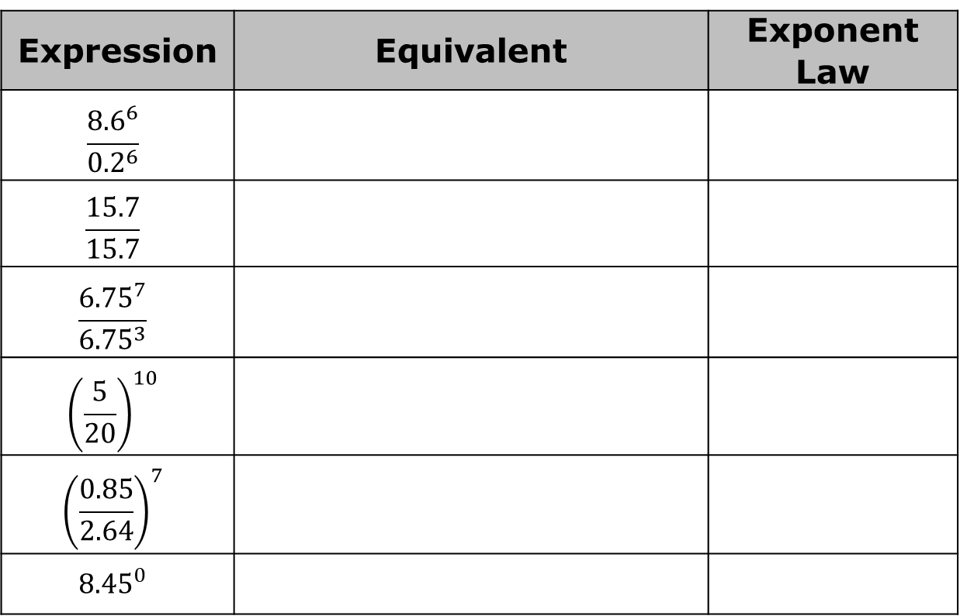
3.2.6 Your Turn!
Rewrite the expressions using laws of exponents. State the exponent law used.
Expression | Equivalent | Exponent Law
$$\frac{{8.6}^{6}}{{0.2}^{6}}$$
$$\frac{15.7}{15.7}$$
$$\frac{{6.75}^{7}}{{6.75}^{3}}$$
$${\left(\frac{5}{20}\right)}^{10}$$
$${\left(\frac{0.85}{2.64}\right)}^{7}$$
$${8.45}^{0}$$
volume 1, pg. 111

Slide 31

Wrap-Up
volume 1, pg. 111

Slide 32

3.2.7 Wrap-Up: Cool Down
volume 1, pg. 111

